Slide 1
Week 5 Synchronous Session
Week of February 14th, 2022

Slide 2
Agenda
Logistics
Week 4 Quiz
Week 4 In-Module Exercises
Week 3 Assignment: Key Principles
More spatial considerations
Practice!
Intro to Week 5

Slide 3
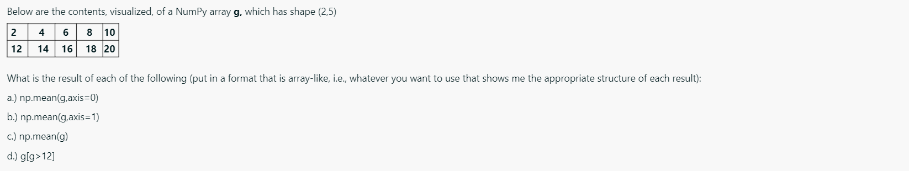
Week 4 Quiz
(a) Average over all rows in each column – [7 9 11 13 15]
axis = 0

Slide 4
Week 4 Quiz
(b) Average over all columns in each row – [6 16]
axis = 1

Slide 5
Week 4 Quiz
(c) Average over both rows and columns: 11

Slide 6
Week 4 Quiz
g>12
F | F | F | F | F
F | T | T | T | T
(d)

Slide 7
Week 4 Quiz
g[g>12]
14 | 16 | 18 | 20
(d)

Slide 8
Week 4 Quiz
Description of what happens in while loop

Slide 9
Week 4 In-Module Exercises
Careful with while loop – want to start with i = 1
Logical/comparison operations – we did over full array, not specifying any axis

Slide 10
Week 3 Assignment: Key Principles to Review
Spatial data: Longitude is x-coordinate, latitude is y-coordinate
Later in lab: review -180W to 180E vs. 0 to 360E system
The power of vectorized operations – can often avoid loops in your codes
Example: Week 4 In-Module Exercises, converting temperature units
Example: Week 3 Assignment, evaluating NaNs
If you don’t specifically index a given dimension, you are using/accessing the full range of that dimension inherently – i.e., data[:,:] = data, since not indexing!
No for loops needed in Week 3 Assignment, especially to plot the salinity, temperature, pressure profiles at ALL locations!
Always use descriptive titles on plots!
More in later weeks on subplotting, plot sizes/shapes, etc!

Slide 11
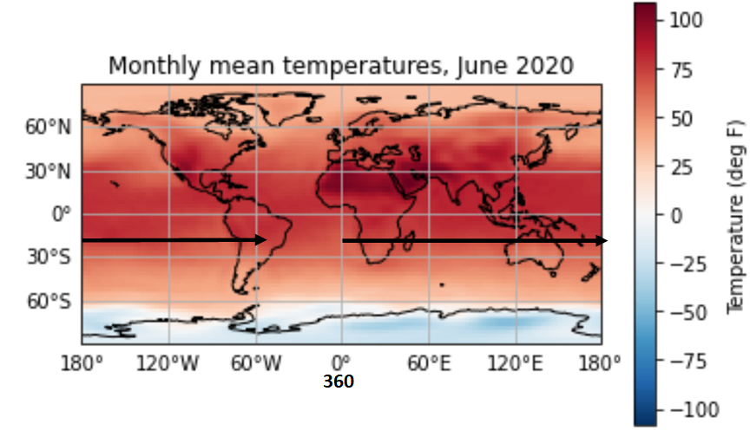
Special considerations with spatial coordinates
What if I have a longitude of -60W, but need it in the 0-360E coordinates?
360-60 = 300 deg E
Another way to think of it – start at 0E, travel counterclockwise around globe
until reach -60W. 180+ 120 = 300 deg E
1 reply
Alicia Klees 1 day ago
Other perspective: following the arrows.....180 deg + 120 deg = 300 degrees E, for the -60 deg W.

Slide 12
Let’s practice!
11 AM
3 PM
Surface →
Vertical level 1
90 | 95
87 | 88
85 | 86
80 | 82
Vertical level 2
Vertical level 3
Highest height →
Vertical level 4
Let’s say you have an array of temperature data, in degrees Fahrenheit, collected from a sounding (balloon with instrument packages that rises into the air) launched from the Natural History Building on campus
Temperatures are collected at 4 vertical levels above the surface
Vertical level 1 = the surface
Vertical level 4 = the highest height above the surface
Temperatures are collected at 2 times – at 11 AM and at 3 PM

Slide 13
Looking ahead
All things 2D plotting

